Slide 1





Astro-sage Sales Analysis
Divyansh Singh Rathaur
21. 01. 2025

Slide 2

Introduction to Astro-sage
AstroSage is a website and app that provides astrology services, including horoscope matching, birth chart generation, and AI astrologers.
AstroSage is used by many astrologers to create birth charts and match horoscopes.
AstroSage is used by Hindus to make decisions about marriage, opening a business, or moving to a new home .

Slide 3

Data Overview
There are 4 different consulataion service that Astrosage offers
In total 149 Consultants are avialable.
A good dataset is important to understand the operational cost , customer satisfaction and trend in the sales of call center.
This dataset enable us to predict and suggest future investments to grow the sales Turnover.

Slide 4




Methodology
Data Cleaning -: Used spreadsheets functions like trim and Removing duplicates for data cleaning.
Data Enrichment -: Added new variables using Date functions for better analysis .
Customer Segmentation -: Used Sorting and Filtering to classify customers based on consultation type.
Used Pivot tables to analyze the performance of consultants over different category type and ratings recieved on basis of consultations from users.
Visulaization -: Created interactive dashboard using different charts for detailed view of dataset.

Slide 5
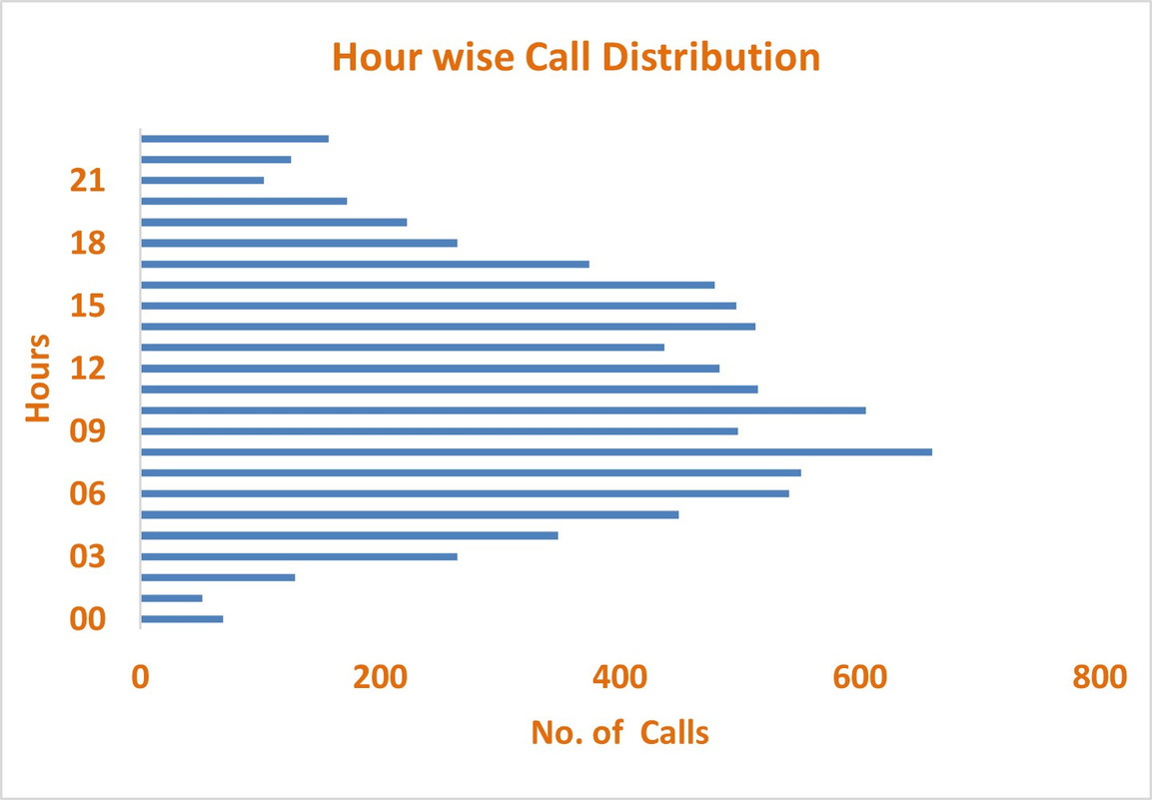
Key Metrics
The above graph shows the hour wise call distribution.
660 calls are the most in a single an hour .
The mid-morning hours generally recieves more number of calls round the whole day
as per the dataset.

Slide 6
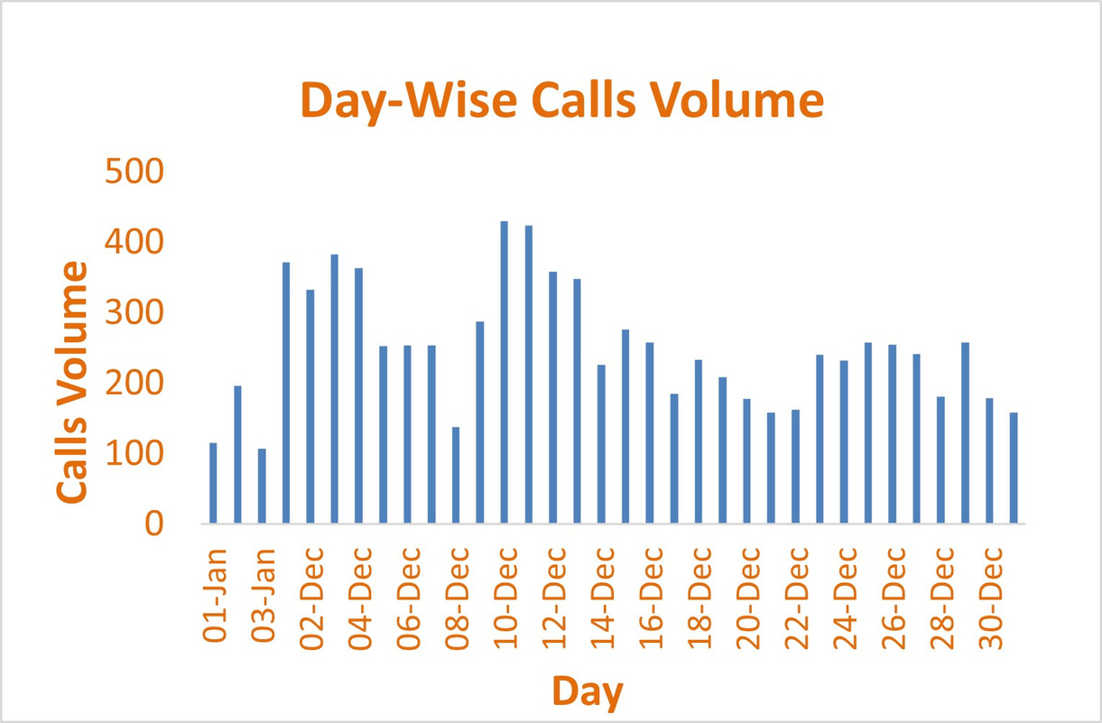
Key Metrics
The above graph shows the Day-wise call distribution.
430 calls is the maximum amount of call received on a single day.
On an average the call center recieves around 250 calls on a daily basis.

Slide 7
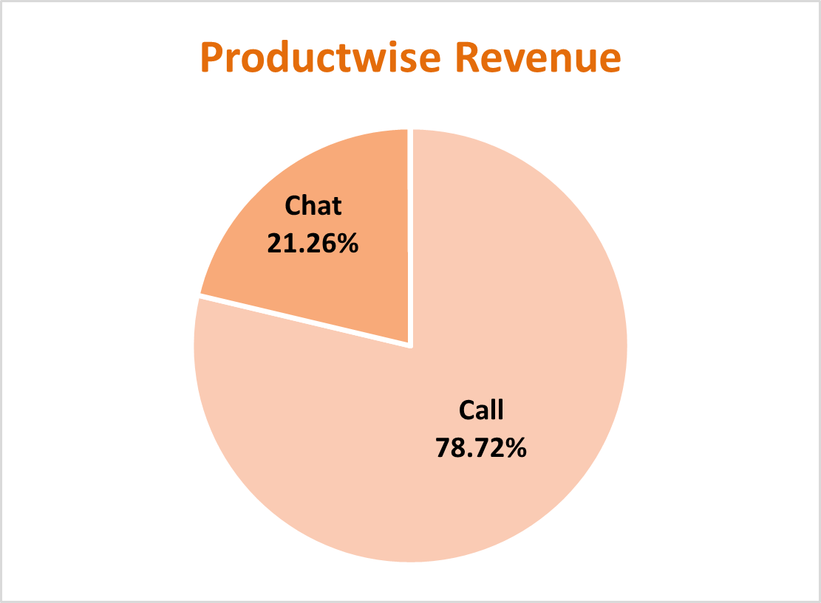
Key Metrics
Product-wise revenue Pie Chart , presents a detailed insight about the revenue generated by different consultation-types as per the percentage of total revenue.
Product-wise revenue Pie Chart , presents an impactful insight that the calls consulation are most profitable.

Slide 8
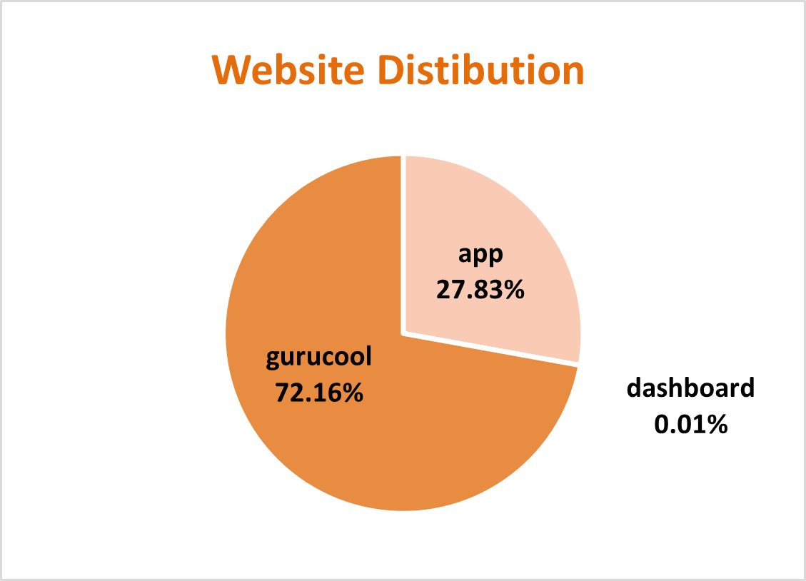
Key Metrics
The website distribution pie chart is presented with the different websites showing count consultations through different website chanells.
The least amount of consultations appear from dashboard.
The most amount consultations are from gurucool.

Slide 9
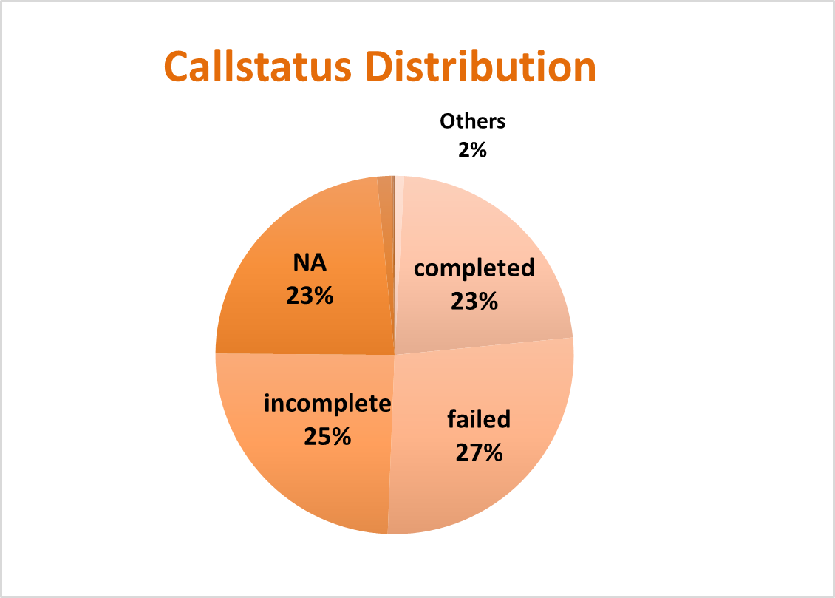
Key Metrics
The call-status pie chart is presented with the different responses by the user i.e. the end result of consultation.
The completed calls are 25%
There are the most amount failed calls.
The NA represents the consultations done on any other consultation-type than calls.

Slide 10
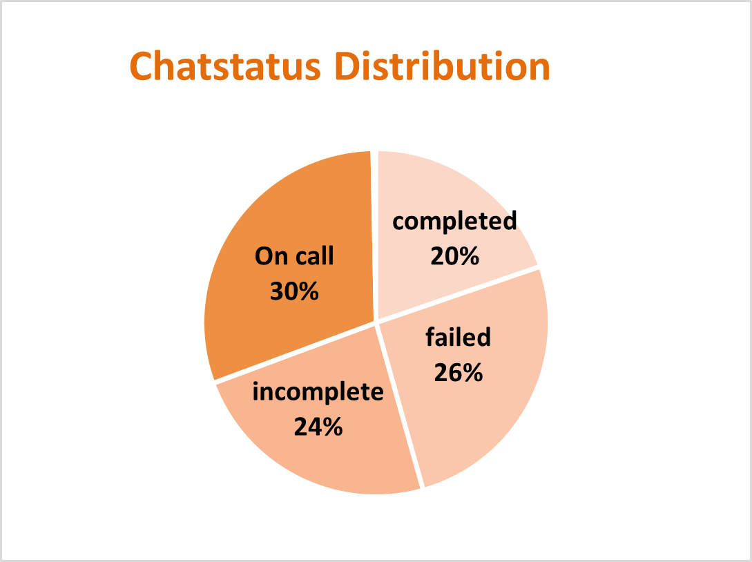
Key Metrics
The chat-status pie chart is presented with the different responses by the user i.e. the end result of consultation.
The completed chats are 20%
There are the most amount failed chats.
The On call represents the consultations done on any other consultation-type than calls.

Slide 11
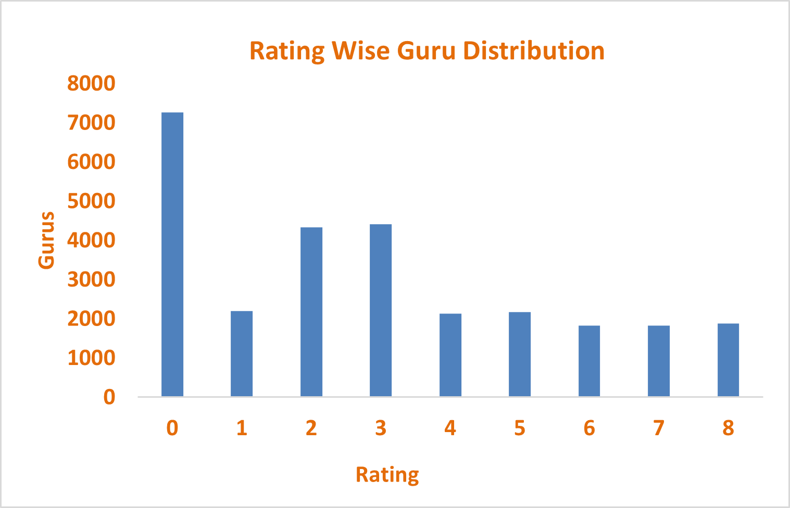
Key Metrics
The column chart represents the rating-wise guru distribution.
The ratings of Gurus that consulted on chats is better than on calls.
The calls consultation needs to be worked on and improve to increase the quality of consultation.

Slide 12
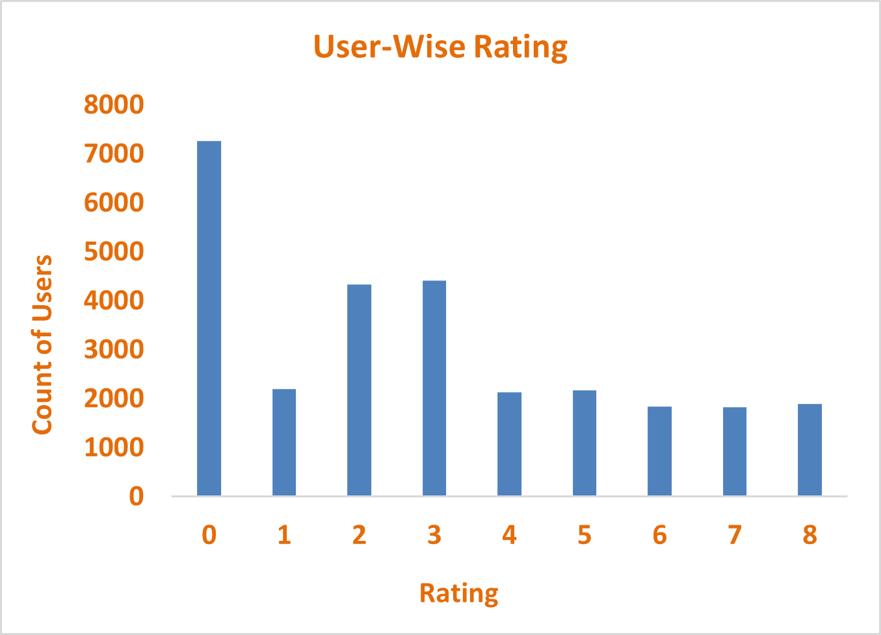
Key Metrics
The column chart represents the rating-wise user distribution.
The ratings of users who were consulted on chats is better than on calls.
The calls consultation needs to be worked on and improve to increase the quality of consultation.

Slide 13
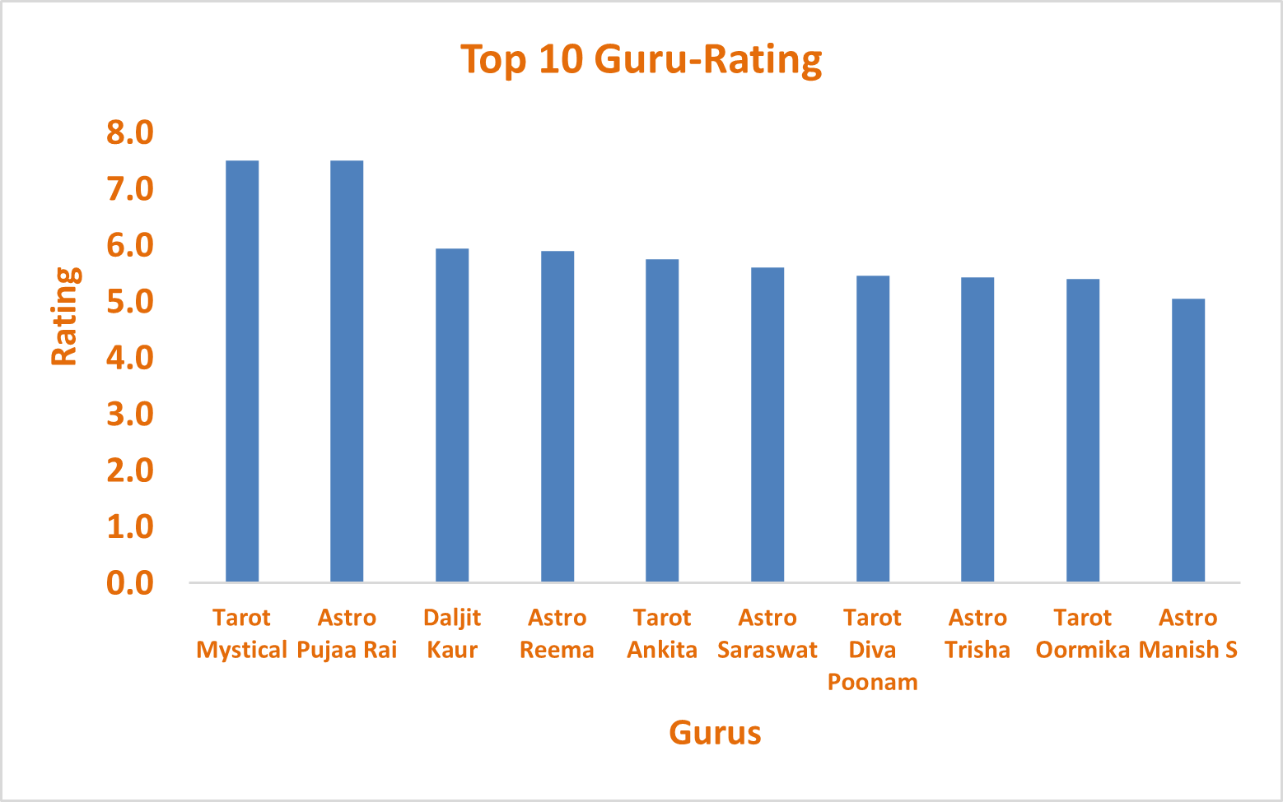
Key Metrics
The column chart represents the Top rated Gurus.
7.5 is the average highest rating received by the Tarot Mystical and
Astro Puja Rai.
The average rating of the Top 10 Gurus is 5.5.

Slide 14
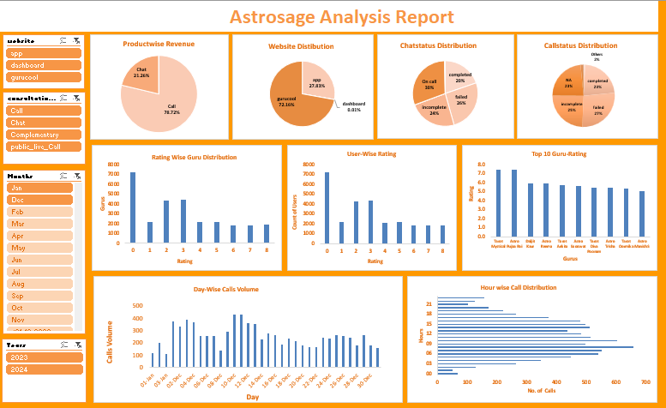

Slide 15
The Dasboard consists of following metrics
Consulationwise revenue
4 Slicers to Visulalize filtered results.
Callstatus and Chatstatus Distribution
Website Distribution
Website
Astrologer-wise Rating
Consultation Type
Day and Hourwise Calls
Months
Top 10 Guruwise Rating
Year
Userwise Rating

Slide 16

Strategic Initiatives
Astro-sage should focus upon Technological upgrades to bring customers to the app and dashboard more frequently and decrease the cancelled and failed consultations to improve the profitability.
Astro-sage should focus on call consultations to increase the revenue and installs some chatbots and virtual assistant for general chat process instead of consultants to have them available for the peak hours to reduce the operational cost.
Astro sage should focus upon the pre-booking model and include CRM Software to assign a particular client to a particular customer to increase customer satisfaction and reduce time lapse and repetitive procedure of intro sessions.
Finally, Astro- sage must allow a customer to choose a consultant and take feedbacks of the session. And weekly distribute the most rated and most appreciated astrologer’s session recording to others and organize regular training to stay up to date and keep all the consultants on the same level , to maintain the quality and consistency of the session.

Slide 17

Upgrading technology and streamlining operations can enhance profitability and customer satisfaction.
Introducing pre-booking and CRM systems will improve efficiency and reduce repetitive processes.
Using chatbots for general queries will lower operational costs and reserve consultants for peak hours.
Focusing on call consultations can increase revenue and customer engagement.
Allowing customers to choose consultants and collecting feedback will build trust and loyalty.
Conclusion
& Recomendations

Slide 18
Recognizing top consultants and organizing regular training will ensure consistent service quality.
These strategies will improve efficiency, reduce costs, and enhance the overall customer experience.
The calls consultation need an improvement so the call center can focus on a better training model to complete the consultation with better consumer satisfaction in a lesser span of time, eventually resulting in better ratings.
Conclusion
& Recomendations

